Slide 1





SALES REPORT OVERVIEW
Enhancing Sales Strategy
By : Saravana Kumar

Slide 2


ABOUT THE DATA :
A real time sales and purchase data for the years 2023 and 2024 has been collected from a metals manufacturing company in Madurai,Tamil Nadu
Source :
Senthil_andavar_data_files

Slide 3




DATA SUMMARY
.
Total Rows: 257
Date Range: 1st April 2023 – 31st March 2024
Unique Customers : 28
Voucher Type: Gst Sales
Unique Voucher Numbers: 257
Gross Total & Tax Details: Varies across transactions, with applicable CGST, SGST, and occasional rounding adjustments or IGST.

Slide 4



COLUMNS EXPLANATION :
S.No | Column Name | Description
1 | Date | Transaction date.
2 | Particulars | Name of the customer or business entity.
3 | Voucher Type | Type of transaction (only "Gst Sales").
4 | Voucher No. | Unique identifier for each transaction.
5 | Quantity | Quantity of goods sold (in kgs).
6 | Rate | Price per kg of goods sold.
7 | Value | Total value before tax.
8 | Gross Total | Total transaction amount after tax.
9 | Gst Sales | Total sales amount subject to GST.
10 | Ou Cgst | Central GST amount.
11 | Ou Sgst | State GST amount.
12 | Round Off | Adjustment for rounding differences.
13 | Ou Igst | Integrated GST amount (if applicable).
14 | Tcs Charges | Tax Collected at Source (if applicable).

Slide 5


DATA TRANSFORMATION
.
Splitting by "Kgs", "Dr", "Cr"
The "Quantity (Kgs)" column ensures that weight-based data is isolated for accurate calculations.
The "Gross Total (Dr)" and "GST Sales (Cr)" fields clearly indicate Debit (Dr) and Credit (Cr) transactions, which were likely extracted from a combined financial column.
Other tax-related fields (CGST, SGST, IGST, and Round_Off) were also handled separately, possibly by splitting mixed values containing both numbers and text.
Some values have "Cr" or "Dr" notation, indicating credit and debit transactions.
Column Renaming & Formatting:
The data columns are changed to well structured column name,renamed or formatted the headers for better readability.
Example: "Quantity (Kgs)", "Rate (Kgs)", and "Value" are clearly labeled.

Slide 6

DATA TRANSFORMATION
.
Data Cleaning:
Missing or null values (e.g., in some IGST fields) indicate that the data was refined, possibly with conditional handling to avoid errors in calculations.
The data appears to be sorted by date, making it easier for trend analysis.
Prices and tax values are rounded to two decimal places, ensuring accuracy in financial calculations.
Data Type Adjustments:
Some columns contain numerical values that were likely converted from text to numeric types for calculations (e.g., "Quantity (Kgs)", "Rate (Kgs)", "Value").
The "Date" column appears to be properly formatted for date-based analysis.

Slide 7
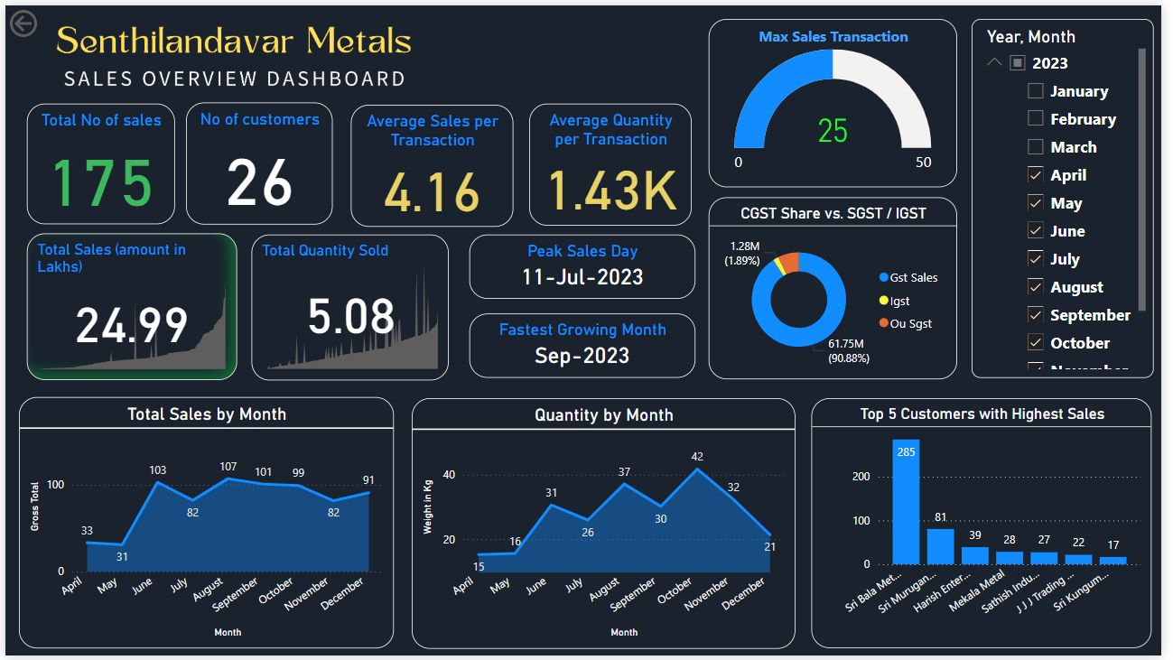
SALES OVERVIEW DASHBOARD

Slide 8
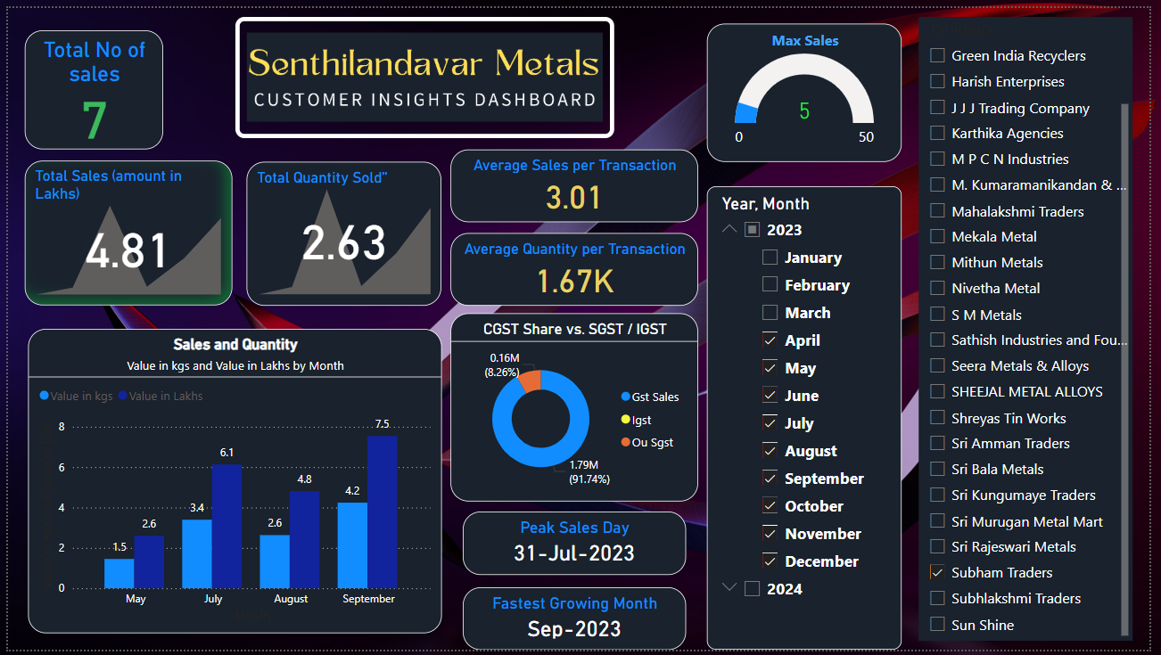
CUSTOMER INSIGHTS DASHBOARD

Slide 9

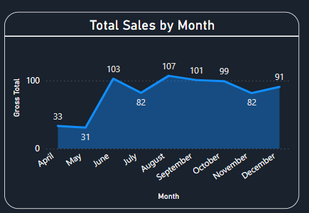
AREA CHART
Total Sales by Month :
Trend analysis of total sales using the sum of gross total over months.
x axis :
Date column (Month)
y axis :
Sum of Gross total in Lakhs
DAX query:
Value in Lakhs = SUM(Sales[Gross Total (Dr)]) / 100000

Slide 10
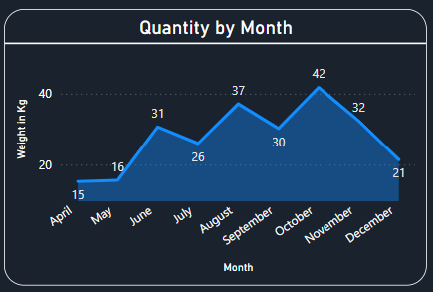
AREA CHART
Quantity sold by Month :
Trend analysis of total quantities of product sold using the sum of Quantity in metric tons (MT)
x axis :
Date column (Month)
y axis :
Sum of Quantity in metric tons (MT)
DAX query:
Value in kgs = SUM(sales[Quantity (Kgs)]) /1000

Slide 11
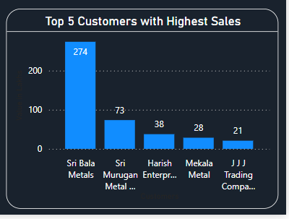
BAR CHART
Top 5 Customers with Highest Sales :
Comparison of top 5 customers based on total sales in lakhs.
x axis :
Particulars column (customers)
y axis :
Sum of Gross total in Lakhs
DAX query:
Value in Lakhs = SUM(Sales[Gross Total (Dr)]) / 100000

Slide 12
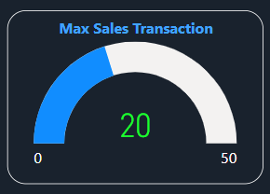
GAUGE CHART
Finding Maximum sales:
Finding the maximum sales in the data
Value:
Maximum value of Gross total
DAX query:
Max Sales Transaction = MAX(sales[Gross Total (Dr)]) /100000

Slide 13
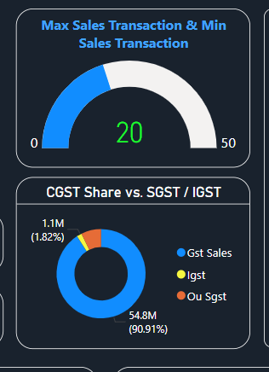
PIE CHART
GST Sales vs IGST vs Ou SGST :
Comparison of GST Sales vs IGST vs Outward SGST
Values :
Sum of Gst sales
Sum of Igst
Sum of cgst

Slide 14
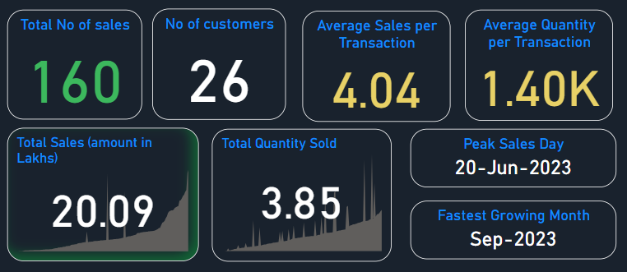
CARD
1.Total no of sales
Distinct count of Gross total
1.
2.
3.
4.
2.Total no of customers
Distinct count of Particulars
3.Average Sales per transaction
Average of Gross total
5.
6.
4.Average quantity per transaction
Average of Quantity
5.Peak Sales Day (Highest sale)
Maximum value from Gross total
6.Fastest Growing month

Slide 15
KPI (KEY PERFORMANCE INDICATOR)
Total Sales in Lakhs
Trend axis :
Sum of Gross total in Lakhs
value :
Value in Lakhs
DAX query:
Value in Lakhs = SUM(Sales[Gross Total (Dr)]) / 100000
Total Quantity sold
Trend axis :
Sum of Gross total in Lakhs
value :
Value in Kgs
DAX query:
Value in kgs = SUM(sales[Quantity (Kgs)]) /1000

Slide 16
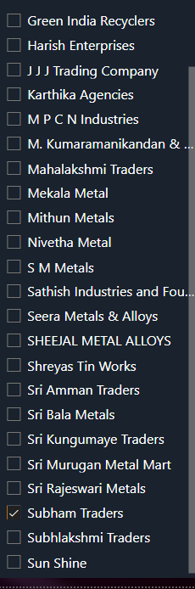
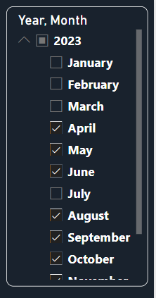
SLICER
Slicer 1 :
Filters sales data by selected year and months using check box
(eg: 2023 ,2024 ,April)
Slicer 2 :
Filters sales data by enables analysis based on specific customers.
(eg : Subham Traders )

Slide 17




OUTCOME & BUSINESS IMPACT
Sales Trend Analysis
Top Customers Identification
Performance Metrics Evaluation
Peak Sales Periods
Helps in identifying peak seasons and slow periods for better planning
Enables focused marketing and customer relationship management
Assists in strategic pricing and promotional campaigns
Helps in setting business goals and improving overall sales strategy

Slide 18



THANK
YOU

